Slide 1
WIP - Development Sprint 1
Project/Database Creation, METEOR
2/19 - 2/26

Slide 2
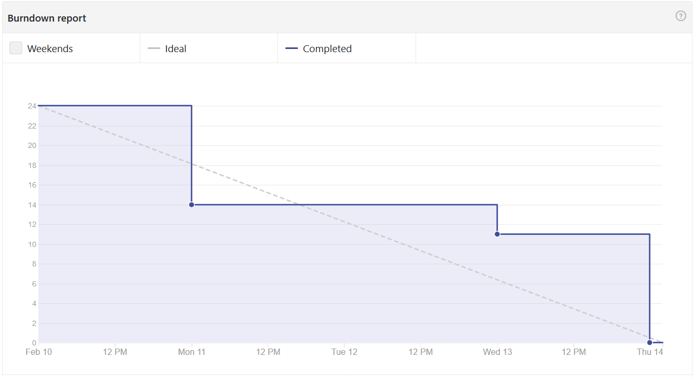
Burndown Chart (Last Week)

Slide 3
Responsibilities - Work Performed
CJ - Scrum master. Create database and insert tables. Begin Hot Dial ‘Call’ implementation and assist with GUI (buttons)
Brian - User Interface, build core specifications
Josh - Build event handler system, build base controller class
Nakava - Assist with build event handler system and create database
Steve - GUI. Code with existing database. Assist with building base controller class requirements

Slide 4
Problems & Solutions
Problems Encountered
Outdated database
Lack of working knowledge of javascript and meteor
Decisions Made
Collaborating with Dr. Sills’ team to work with existing database
Acquiring code learning through online studies to further project

Slide 5
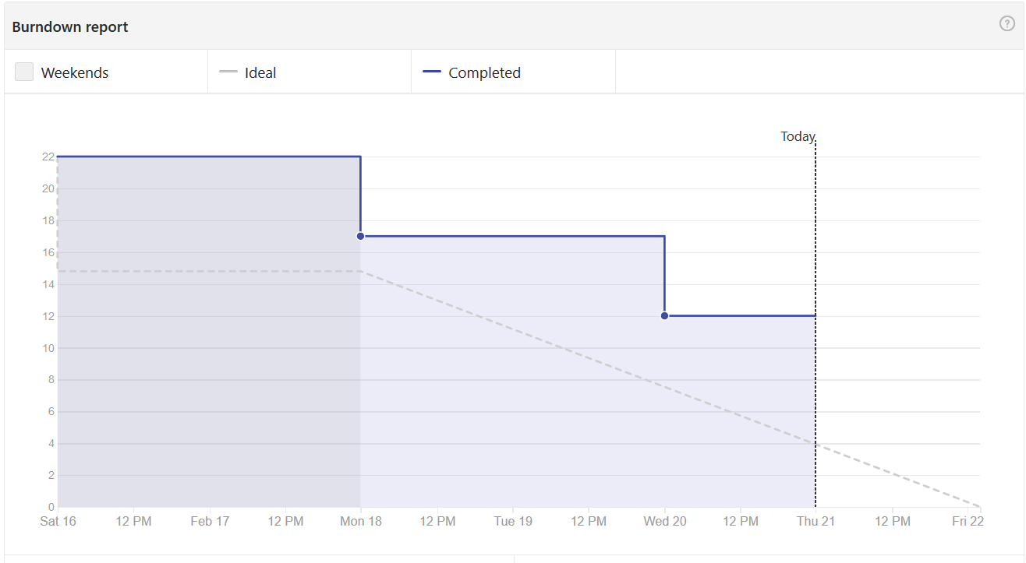
Burndown Chart (This week)

Slide 6
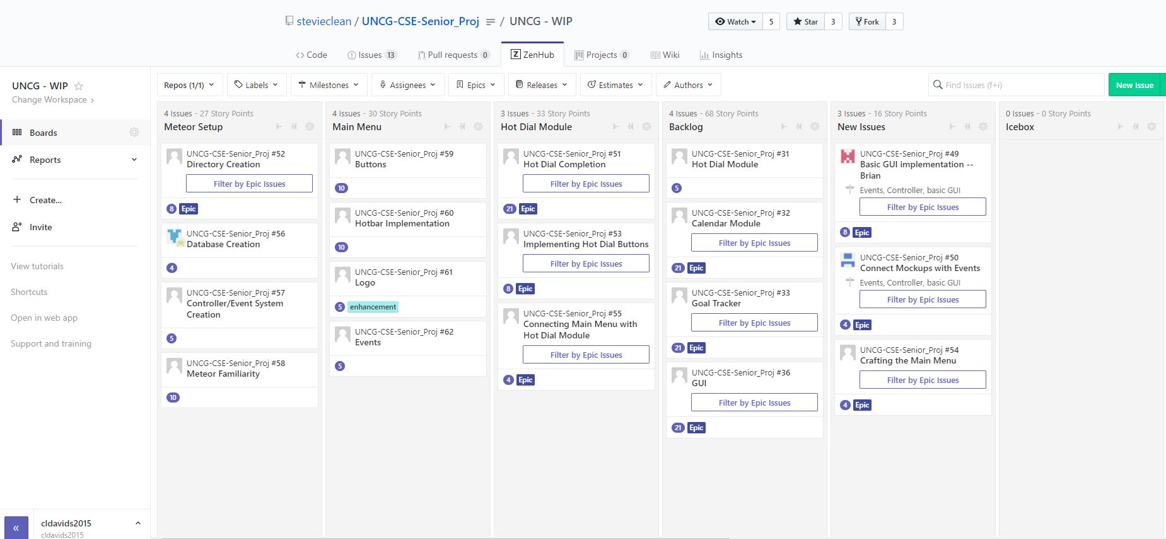
Upcoming
Meteor Structuring
Main Menu
Hot Dial

Slide 7
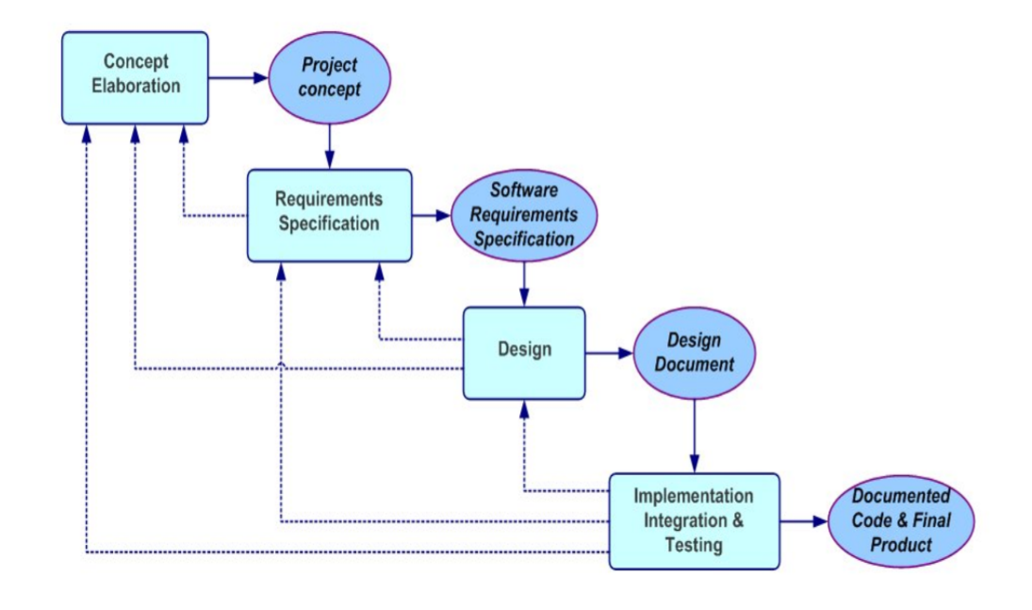
Phases & Deliverables

Slide 8

Any Questions?
We are the future!
THANK YOU!
Follow us at
https://github.com/stevieclean/UNCG-CSE-Senior_Proj

